Slide 1
Hash functions
- Dr. SANJAY H A

Slide 2
Cryptographic primitives
Cryptographic primitives are the basic building blocks of a security protocol or system.
A security protocol is a set of steps taken in order to achieve required security goals by utilizing appropriate security mechanisms.
Various types of security protocols are in use, such as authentication protocols, nonrepudiation protocols, and key management protocols.

Slide 3
Generic cryptography model

Slide 4
Cryptographic primitives
Entity: It is either a person or a system that sends, receives, or performs operations on data
Sender: Sender is an entity that transmits the data
Receiver: Receiver is an entity that takes delivery of the data
Adversary: This is an entity that tries to circumvent the security service
Key: A key is some data that is used to encrypt or decrypt data
Channel: Channel provides a medium of communication between entities

Slide 5
Symmetric cryptography
Symmetric cryptography refers to a type of cryptography whereby the key that is used to encrypt the data is the same for decrypting the data
The key must be established or agreed on before the data exchange between the communicating parties
Also known as a shared key cryptography (secret key Cryptography)
There are two types of symmetric ciphers
Stream ciphers
RC4 and A5
Block ciphers.
Data Encryption Standard (DES) and Advanced Encryption Standard (AES)

Slide 6
Stream ciphers
Encryption algorithms on a bit-by-bit basis to plain text using a key stream.
There are two types of stream ciphers:
Synchronous
Synchronous stream ciphers are ones where key stream is dependent only on the key
Asynchronous.
Asynchronous stream ciphers have a key stream that is also dependent on the encrypted data.
Encryption and decryption are basically the same function because they are simple modulo 2 additions or XOR operation

Slide 7
Example of Stream Encryption
Key
Stream
⊕
Plaintext
=
Ciphertext

Slide 8
Example of Stream Decryption
Key
Stream
⊕
Ciphertext
=
Plaintext

Slide 9
Block ciphers
Encryption algorithms that break up a text to be encrypted (plain text) into blocks of fixed length
Apply encryption block by block.
Block ciphers are usually built using a design strategy known as Fiestel cipher.

Slide 10
Block ciphers
Fiestel ciphers are based on the Fiestel network,
This structure is based on the idea of combining multiple rounds of repeated operations to achieve desirable cryptographic properties knows as confusion and diffusion.
Fiestel networks operate by dividing data into two blocks (left and right) and process these blocks via keyed round functions.

Slide 11
Block cipher encryption modes
Block encryption mode
In this mode, plaintext is divided into blocks of fixed length depending on the type of cipher used and then the encryption function is applied on each block.
Keystream generation modes
In this mode, the encryption function generates a keystream that is then XORed with the plaintext stream in order to achieve encryption.
Message authentication modes
In this mode, a message authentication code is computed as a result of an encryption function.
MAC is basically a cryptographic checksum that provides an integrity service.
The most common method to generate MAC using block ciphers is CBC-MAC, where some part of the last block of the chain is used as a MAC.

Slide 12
Block cipher encryption modes
Cryptographic hashes
Hash functions are basically used to compress a message to a fixed length digest.
In this mode, block ciphers are used as a compression function to produce a hash of plain text.
Electronic code book
This is a basic mode of operation in which the encrypted data is produced as a result of applying the encryption algorithm one by one separately to each block of plain text.
This is the simplest mode but should not be used in practice as it is insecure and can reveal information:

Slide 13
Block encryption modes
Electronic code book

Slide 14
Block cipher encryption modes
Cipher block chaining
In this mode, each block of plain text is XORed with the previous encrypted block.
The CBC mode uses initialization vector IV to encrypt the first block.
It is recommended that IV be randomly chosen

Slide 15
Cipher block chaining
initialization vector (IV)

Slide 16
Block cipher encryption modes
Counter mode
The CTR mode effectively uses a block cipher as a stream cipher.
In this case, a unique nonce is supplied that is concatenated with the counter value in order to produce a key stream:

Slide 17
Counter mode

Slide 18
Data Encryption Standard (DES)
The Data Encryption Standard (DES) is a symmetric-key block cipher published by the National Institute of Standards and Technology (NIST).
DES is an implementation of a Feistel Cipher.
It uses 16 round Feistel structure.
The block size is 64-bit.
Though, key length is 64-bit, DES has an effective key length of 56 bits, since 8 of the 64 bits of the key are not used by the encryption algorithm

Slide 19
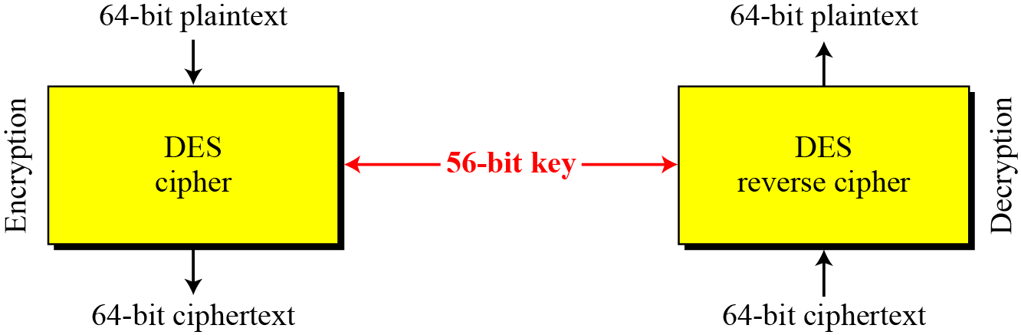
Encryption and decryption with DES

Slide 20
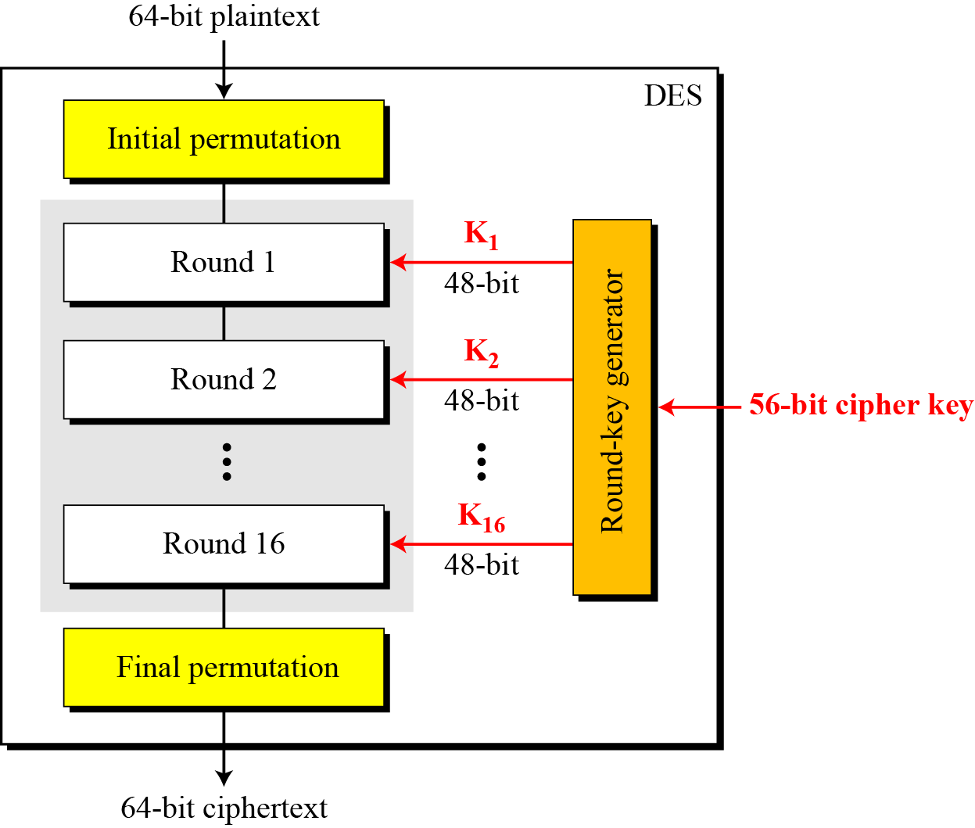
General structure of DES

Slide 21
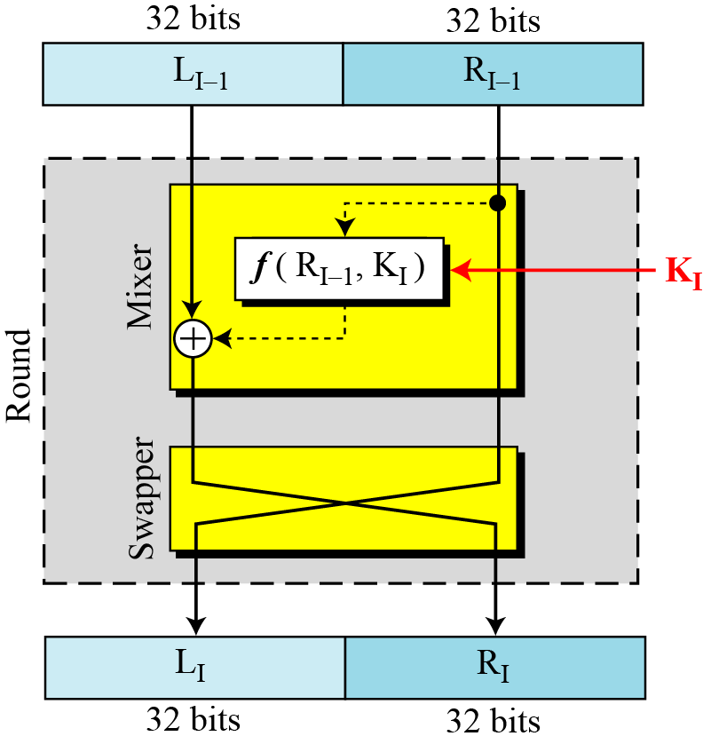
6.2.2 Rounds
DES uses 16 rounds. Each round of DES is a Feistel cipher.
Figure 6.4 A round in DES (encryption site)

Slide 22
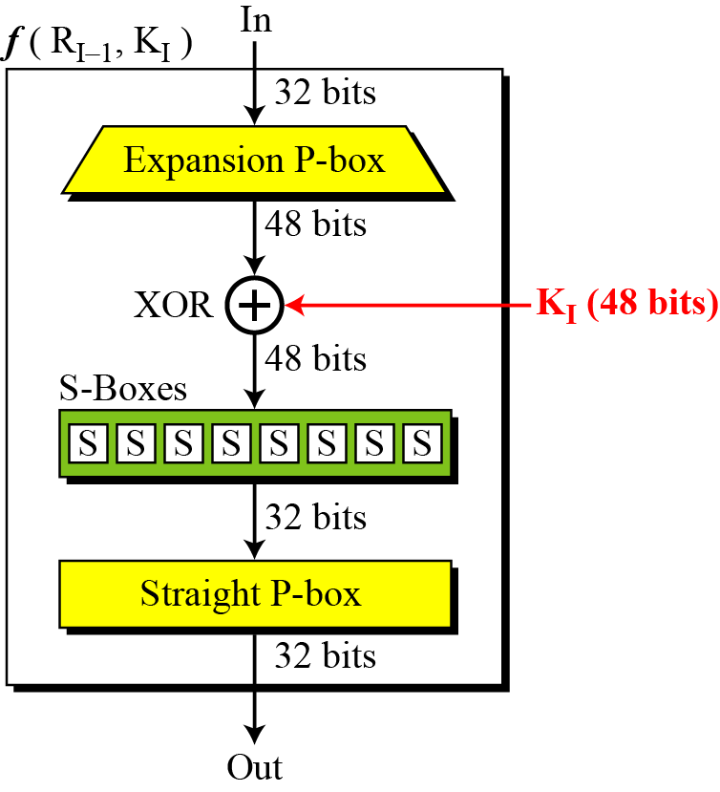
DES Function
The heart of DES is the DES function. The DES function applies a 48-bit key to the rightmost 32 bits to produce a 32-bit output.
Figure 6.5 DES function

Slide 23
Triple DES (3DES), which proposed the usage of a 168-bit key using three 56-bit keys and the same number of executions of the DES algorithm
thus making brute force attacks almost impossible.
Slow performance and 64-bit block size, are not desirable.

Slide 24
Advanced Encryption Standard (AES)
The more popular and widely adopted symmetric encryption algorithm is the Advanced Encryption Standard (AES).
It is found at least six time faster than triple DES.
A replacement for DES was needed as its key size was too small.
With increasing computing power, it was considered vulnerable against exhaustive key search attack.
Triple DES was designed to overcome this drawback but it was found slow.

Slide 25
Advanced Encryption Standard (AES)
No attack has been found against AES that is better than the brute force method.
Original Rijndael allows different key and block sizes of 128-bit, 192-bit, and 256-bits,
But in the AES standard, only a 128-bit block size is allowed.
However, key sizes of 128-bit, 192-bit, and 256-bit are allowed

Slide 26
Operation of AES
AES is an iterative rather than Feistel cipher.
It is based on ‘substitution–permutation network’.
It comprises of a series of linked operations,
some of which involve replacing inputs by specific outputs (substitutions)
others involve shuffling bits around (permutations).
AES performs all its computations on bytes rather than bits. Hence,
AES treats the 128 bits of a plaintext block as 16 bytes.
These 16 bytes are arranged in four columns and four rows for processing as a matrix

Slide 28
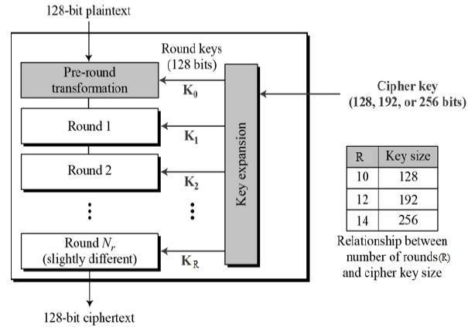

Slide 29
Asymmetric cryptography
Asymmetric cryptography refers to a type of cryptography whereby the key that is used to encrypt the data is different from the key that is used to decrypt the data.
Also known as public key cryptography
It uses public and private keys in order to encrypt and decrypt data, respectively.

Slide 32
Public key cryptography algorithms are based on various underlying mathematical problems
Integer factorization
These schemes are based on the fact that large integers are very hard to factor
Discrete logarithm
This is based on a problem in modular arithmetic that it is easy to calculate the result of modulo function but it is computationally infeasible to find the exponent of the generator.
Elliptic curves
This is based on the discrete logarithm problem, but in the context of elliptic curves.
Elliptic curve is an algebraic cubic curve over a field

Slide 33
RSA
RSA was invented in 1977 by Ron Rivest, Adi Shamir, and Leonard Adelman
This is based on the integer factorization problem, where the multiplication of two large prime numbers is easy but difficult to factor it back to the two original numbers.
Modulus generation:
Select p and q very large primes
Multiply p and q , n=p.q to generate modulus n
Generate co-prime:
Number should satisfy certain conditions, that is, it should be greater than 1 and less than (p-1) (q-1). I
e must be such a number that no number other than 1 can be divided into e and (p-1) (q-1). This is called co-prime, that is, e is the co-prime of (p-1)(q-1).

Slide 34
Generate public key:
Modulus generated in step 1 and e generated in step 2 is pair that, together, is a public key.
This part is the public part that can be shared with anyone;
p and q need to be kept secret.
Generate private key:
Private key called d here and is calculated from p, q and e.
Private key is basically the inverse of e modulo (p-1)(q-1).

Slide 35
Encryption and decryption using RSA
Plain text P is raised to e number of times and then reduced to modulo n.
Receiver who has a public key pair (n, e) can decipher the data by raising C to the value of the private key d and reducing to modulo n

Slide 36
Definition of Elliptic curves
An elliptic curve over a field K is a nonsingular cubic curve in two variables, f(x,y) =0 with a rational point (which may be a point at infinity).
The field K is usually taken to be the complex numbers, reals, rationals, algebraic extensions of rationals, p-adic numbers, or a finite field.
Elliptic curves groups for cryptography are examined with the underlying fields of F_{p} (where p>3 is a prime) and F₂^{m} (a binary representation with 2^{m} elements).

Slide 37
What is Elliptic Curve Cryptography?
Implementing Group Operations
Main operations - point addition and point multiplication
Adding two points that lie on an Elliptic Curve – results in a third point on the curve
Point multiplication is repeated addition
If P is a known point on the curve (aka Base point; part of domain parameters) and it is multiplied by a scalar k, Q=kP is the operation of adding P + P + P + P… +P (k times)
Q is the resulting public key and k is the private key in the public-private key pair

Slide 39
Generic Procedures of ECC
Both parties agree to some publicly-known data items
The elliptic curve equation
values of a and b
prime, p
The elliptic group computed from the elliptic curve equation
A base point, B, taken from the elliptic group
Similar to the generator used in current cryptosystems
Each user generates their public/private key pair
Private Key = an integer, x, selected from the interval [1, p-1]
Public Key = product, Q, of private key and base point
(Q = x*B)

Slide 40
Elliptic Curve Cryptography
Components
Private Key | Public Key | Set of Operations | Domain Parameters (Predefined constants)
A random number | Point on a curve = Private Key * G | These are defined over the curve y² = x³ + ax + b, where 4a³ + 27b² ≠ 0 | G, a, b

Slide 41
Why use ECC?
How do we analyze Cryptosystems?
How difficult is the underlying problem that it is based upon
RSA – Integer Factorization
DH (Diffie–Hellman) – Discrete Logarithms
ECC - Elliptic Curve Discrete Logarithm problem
How do we measure difficulty?
We examine the algorithms used to solve these problems

Slide 42
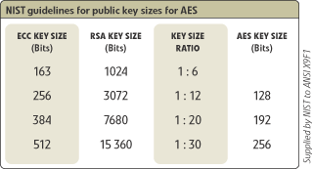
Security of ECC
To protect a 128 bit AES key it would take a:
RSA Key Size: 3072 bits
ECC Key Size: 256 bits
How do we strengthen RSA?
Increase the key length
Impractical?

Slide 43
Applications of ECC
Many devices are small and have limited storage and computational power
Where can we apply ECC?
Wireless communication devices
Smart cards
Web servers that need to handle many encryption sessions
Any application where security is needed but lacks the power, storage and computational power that is necessary for our current cryptosystems

Slide 44
Benefits of ECC
Same benefits of the other cryptosystems: confidentiality, integrity, authentication and non-repudiation but…
Shorter key lengths
Encryption, Decryption and Signature Verification speed up
Storage and bandwidth savings

Slide 45
Summary of ECC
“Hard problem” analogous to discrete log
Q=kP, where Q,P belong to a prime curve
given k,P → “easy” to compute Q
given Q,P → “hard” to find k
known as the elliptic curve logarithm problem
k must be large enough
ECC security relies on elliptic curve logarithm problem
compared to factoring, can use much smaller key sizes than with RSA etc
for similar security ECC offers significant
computational advantages

Slide 46
Cryptographic primitives

Slide 47
Hash Functions
A hash function maps a message of an arbitrary length to a m-bit output
output known as the fingerprint or the message digest
What is an example of hash functions?
Give a hash function that maps Strings to integers in [0,2^{32}-1]
Cryptographic hash functions are hash functions with additional security requirements
Notes:
Example hash function: v:=1; for each character c, v=v*(c+1)+2 mod 2^{32};

Slide 48
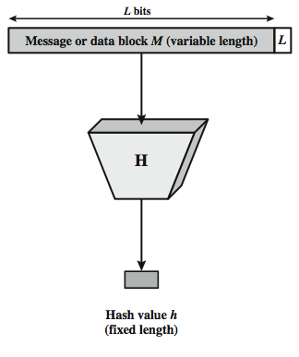
Cryptographic Hash Function
Notes:
Stallings Figure 11.1 depicts the general operation of a cryptographic hash function. Typically, the input is padded out to an integer multiple of some fixed length (e.g., 1024 bits) and the padding includes the value of the length of the original message in bits. The length field is a security measure to increase the difficulty for an attacker to produce an alternative message with the same hash value.
48

Slide 49
Hash functions
Hash functions are used to create fixed length digests of arbitrarily long input strings.
Hash functions are keyless and provide the data integrity service.
They are usually built using iterated and dedicated hash function construction techniques.
Various families of hash functions are available, such as MD, SHA1, SHA-2, SHA-3, RIPEMD, and Whirlpool.
Hash functions are commonly used in digital signatures and message authentication codes, such as HMACs.

Slide 50
Hash functions
Hash functions have three security properties, namely
pre-image resistance
second preimage resistance
collision resistance
Hash functions are typically used to provide data integrity services.
Hash functions can be used as one-way functions and to construct other cryptographic primitives, such as MACs and digital signatures.
Some applications used hash functions as a means of generating pseudo random numbers (PRNGs).
Hash functions do not require a key.

Slide 51
Two practical properties of hash functions
Compression of arbitrary messages into fixed length digest
This property is concerned with the fact that a hash function must be able to take a long input text of any length and output a fixed length compressed message.
Hash functions produce a compressed output in various bit sizes, usually between 128-bits and 512-bits.
Easy to compute
Hash functions are efficient and fast one-way functions.
Requirement is that they be very quick to compute regardless of the message size.
The efficiency may decrease if the message is too big but the function should still be fast enough for practical use.

Slide 52
Security properties of hash functions
Pre-image resistance (one-way property)
h(x) = y
h is the hash function, x is the input, and y is the hash.
The first security property requires that y cannot be reverse computed to x.
x is considered a pre-image of y
Second pre-image resistance (weak collision resistance)
This property requires that given x and h(x)
It is almost impossible to find any other message m ,
where m != x and hash of m = hash of x i.e h(m) = h(x)

Slide 53
Security properties of hash functions
Collision resistance (strong collision resistance)
This property requires that two different input messages should not hash to the same output.
In other words, h(x) != h(z).

Slide 54
Security Requirements for Cryptographic Hash Functions
Given a function h:X →Y, then we say that h is:
preimage resistant (one-way):
if given y ∈Y it is computationally infeasible to find a value x ∈X s.t. h(x) = y
2-nd preimage resistant (weak collision resistant):
if given x ∈ X it is computationally infeasible to find a value x’ ∈ X, s.t. x’≠x and h(x’) = h(x)
collision resistant (strong collision resistant):
if it is computationally infeasible to find two distinct values x’,x ∈ X, s.t. h(x’) = h(x)

Slide 56
Attacks on Hash Functions
have brute-force attacks and cryptanalysis
a preimage or second preimage attack
find y s.t. H(y) equals a given hash value
collision resistance
find two messages x & y with same hash so H(x) = H(y)
hence value 2^{m/2} determines strength of hash code against brute-force attacks
128-bits inadequate, 160-bits suspect
Notes:
As with encryption algorithms, there are two categories of attacks on hash functions: brute-force attacks and cryptanalysis. A brute-force attack does not depend on the specific algorithm but depends only on bit length. In the case of a hash function, a brute-force attack depends only on the bit length of the hash value. A cryptanalysis, in contrast, is an attack based on weaknesses in a particular cryptographic algorithm.
For a preimage or second preimage attack, an adversary wishes to find a value y such that H(y) is equal to a given hash value h. The brute force method is to pick values of y at random and try each value until a collision occurs. For an m-bit hash value, the level of effort is proportional to 2^{m}. Specifically, the adversary would have to try, on average, 2^{m–1} values of y to find one that generates a given hash value h.
For a collision resistant attack, an adversary wishes to find two messages or data blocks, x and y, that yield the same hash function: H(x) = H(y). This requires much less effort than a preimage or second preimage attack. The effort required is explained by a mathematical result referred to as the birthday paradox (next slide).
If collision resistance is required, then the value 2^{m/2} determines the strength of the hash code against brute-force attacks. Van Oorschot and Wiener presented a design for a $10 million collision search machine for MD5, which has a 128-bit hash length, that could find a collision in 24 days. Thus a 128-bit code may be viewed as inadequate. The next step up, if a hash code is treated as a sequence of 32 bits, is a 160-bit hash length. With a hash length of 160 bits, the same search machine would require over four thousand years to find a collision. With today's technology, the time would be much shorter, so that 160 bits now appears suspect.
56

Slide 57
Hash functions
Hash functions, due to their very nature, will always have some collisions
That is where two different messages hash to the same output
But they should be computationally infeasible to find.
A concept known as avalanche effect is desirable in all hash functions.
Avalanche effect specifies that a small change, even a single character change in the input text, will result in a totally different hash output.

Slide 58
Hash functions
Hash functions are usually designed by following iterated hash functions approach.
The input message is compressed in multiple rounds on a block-by-block basis to produce the compressed output.
A popular type of iterated hash function is Merkle- Damgard construction.
This construction is based on the idea of dividing the input data into equal sizes of blocks and then feeding them through the compression functions in an iterative manner.
The collision resistance of the property of compression functions ensures that the hash output is also collision-resistant.
Compression functions can be built using block ciphers.

Slide 59
Internals of a Hash Function
Merkle-Damgard construction:
A fixed-size “compression function”.
Each iteration mixes an input block with the prev. output.
m =
x₁
x₂
. . .
x_{n}
m
y_{i-1}
compression
fnc.
H(m)
x_{i}
y_{i}
y_{n}
y_{i-1}||x_{i}

Slide 60
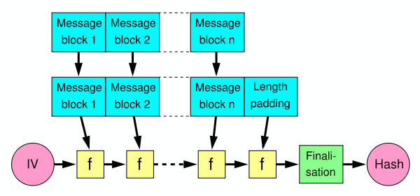
Merkle-Damgard Construction for Hash Functions
Message is divided into fixed-size blocks and padded
Uses a compression function f, which takes a chaining variable (of size of hash output) and a message block, and outputs the next chaining variable
Final chaining variable is the hash value
M=m₁m₂…m_{n}; C₀=IV, C_{i+1}=f(C_{i},m_{i}); H(M)=C_{n}

Slide 61
Message Digest (MD)
Message Digest functions were very popular in early 1990s.
MD4 and MD5 are members of this category.
Both MD functions are found to be insecure and not recommended for use any more.
MD5 is a 128-bit hash function that was commonly used for file integrity checks.
Algorithm takes as input a message of arbitrary length and produces as output a 128-bit 'fingerprint' or 'message digest' of the input.
It is computationally infeasible to produce two messages having the same message digest, or to produce any message having a given pre-specified target message digest

Slide 62
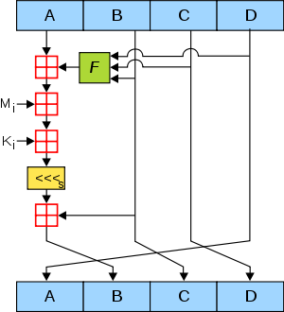
MD5
64 rounds of:
Rivest, 1991
Based on Davies-Meyer const.
Very popular until recently.
2004: First collision attacks
2008: Practical collision attack; SSL cert. with same MD5 hash.
2010: Forged Microsoft MD5 certificates used in Flame malware
Preimage resistance: Mostly ok.

Slide 63
MD5 Algorithm
Step 1 – append padded bits:
Step 2 – append length:
Step 3 – Initialize MD Buffer
Step 4- Process message in 16-word blocks
Step 5 – output

Slide 64
Secure Hash Algorithms (SHAs)
SHA-0:
This is a 160-bit function introduced by NIST in 1993.
SHA-1:
SHA-1 was introduced later by NIST as a replacement of SHA-0.
This is also a 160-bit hash function.
SHA-1 is used commonly in SSL(Secure Sockets Layer ) and TLS (Transport Layer Security) implementations.
It should be noted that SHA-1 is now considered insecure and is being deprecated by certificate authorities.

Slide 65
Secure Hash Algorithms (SHAs)
SHA-2:
This category includes four functions defined by the number of bits of the hash:
SHA-224, SHA-256, SHA-384 and SHA-512.
SHA-3:
This is the latest family of SHA functions.
SHA3-224, SHA3-256, SHA3-384 and SHA3-512 are members of this family.
SHA3 is a NIST-standardized version of Keccak.
Keccak uses a new approach called sponge construction instead of the commonly used Merkle-Damgard transformation.

Slide 66
Secure Hash Algorithms (SHAs)
RIPEMD:
RIPEMD is the acronym for RACE Integrity Primitives Evaluation Message Digest.
It is based on the design ideas used to build MD4.
There are multiple versions of RIPEMD, including 128-bit, 160-bit, 256-bit, and 320-bit.
Whirlpool:
This is based on a modified version of Rijndael cipher known as W.
It uses the Miyaguchi-Preneel compression function, which is a type of one-way function used for the compression of two fixed length inputs into a single fixed length output.
It is a single block length compression function:

Slide 67
Applications
Hash functions have many practical applications ranging from simple file integrity checks and password storage to be used in cryptographic protocols and algorithms.
Applications: hash tables, distributed hash tables, bloom filters, virus finger printing, peer-to-peer P2P file sharing, and many other applications.
In blockchain, hash functions play a very vital role.
Especially, the proof of work function uses SHA-256 twice in order to verify the computational effort spent by miners.
RIPEMD 160 is used to produce bitcoin addresses.

Slide 68
Design of Secure Hash Algorithms (SHA): SHA-256
SHA-256 has the input message size < 2^64-bits.
Block size is 512-bits and has a word size of 32-bits.
Output is 256-bit digest.
The compression function processes a 512-bit message block and a 256-bit intermediate hash value.
There are two main components of this function:
compression function
message schedule.

Slide 69
The algorithm works as follows (SHA-256):
Pre-processing:
Padding of the message
To make the length of a block to 512-bits if it is smaller than the required block size of 512-bits.
Parsing the message into message blocks
Ensure that the message and its padding is divided into equal blocks of 512-bits.
Setting up the initial hash value,
which is the eight 32-bit words obtained by taking the first 32-bits of the fractional parts of the square roots of the first eight prime numbers.
These initial values are randomly chosen in order to initialize the process
Gives a level of confidence that no backdoor exists in the algorithm.

Slide 70
Hash computation:
Each message block is processed in a sequence and requires 64 rounds to compute the full hash output.
Each round uses slightly different constants to ensure that no two rounds are the same.
Message schedule is prepared.
Eight working variables are initialized.
Intermediate hash value is calculated.
Message is processed and the output hash is produced:

Slide 72
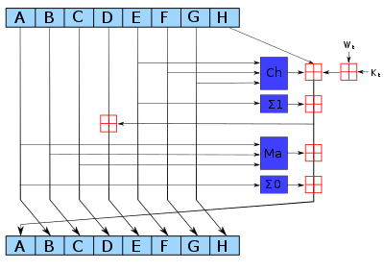

Slide 73
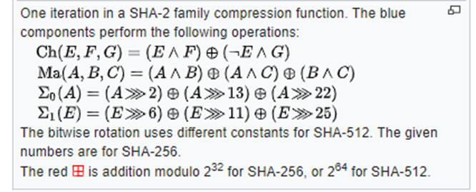

Slide 74

SHA Versions
Notes:
Stallings Table 11.3 provides a comparison of the various parameters for the SHA hash functions.
74

Slide 75
Design of SHA3 (Keccak)
The structure of SHA-3 is very different from the usual SHA-1 and SHA-2.
The key idea behind SHA-3 is based on un-keyed permutations
as opposed to other usual hash functions constructions that used keyed permutations.
Keccak also does not make use of the Merkle-Damgard transformation
New approach called sponge and squeeze construction is used in Keccak,
which is basically a random permutation model.

Slide 76
Design of SHA3
Different variants of SHA3 have been standardized,
SHA3-224, SHA3-256, SHA3-384, SHA3-512, SHAKE128, and SHAKE256.
XOF functions that allow the output to be extended to any desired length.

Slide 77
Absorbing and squeezing function in SHA3

Slide 78
Absorbing and squeezing function in SHA3
As an analogy to sponge, first,
Data is absorbed into the sponge after applying padding,
Data is then changed into a subset of permutation state using XOR
Output is squeezed out of the sponge function that represents the transformed state.
Rate is the input block size of a sponge function,
Capacity determines the generic security level:

Slide 79
Message Authentication codes (MACs)
MACs are sometimes called keyed hash functions
Can be used to provide message integrity and authentication.
In others words, they are used to provide data origin authentication.
MACs are symmetric cryptographic primitives using a shared key between the sender and the receiver.
MACs can be constructed using block ciphers or hash functions.

Slide 80
MACs using block ciphers
Block ciphers are used in the Cipher block chaining mode (CBC mode) in order to generate a MAC.
AES in the CBC mode-can be used.
The MAC of the message is in fact the output of the last round of the CBC operation.
The length of the MAC output is the same as the block length of the block cipher used to generate MAC.
MACs are verified simply by computing the MAC of the message and comparing it with the received MAC.
If they are the same, then the message integrity is confirmed;
otherwise, the message is considered altered.
MACs work like digital signatures, but they cannot provide the nonrepudiation service due to their symmetric nature.

Slide 81
HMACs (hash-based MACs)
Similar to the hash function, they produce a fixed length output and take an arbitrarily long message as the input.
Sender signs a message using MAC
Receiver verifies it using the shared key.
The key is hashed with the message using either of the two methods known as secret prefix or the secret suffix method.
In the first method, the key is concatenated with the message, that is, the key comes first and the message comes after,
In the second method, the key comes after the message:

Slide 83
Merkle trees
The concept of Merkle tree was introduced by Ralph Merkle.
A visualization of Merkle tree makes it easy to understand.
Merkle trees allow secure and efficient verification of large data sets.
It is a binary tree in which first,
inputs are placed at the leaves (node with no children),
values of pairs of child nodes are hashed together in order to produce a value for the parent node (internal node) until a single hash value known as Merkle root is achieved:

Slide 85
Merkle trees
A Merkle tree, in the most general sense, is a way of hashing a large number of “chunks” of data together which relies on splitting the chunks into buckets,
where each bucket contains only a few chunks,
then taking the hash of each bucket and repeating the same process,
continuing to do so until the total number of hashes remaining becomes only one: the root hash.

Slide 86
Patricia trees
Trie or a digital tree is an ordered tree data structure used to store a dataset.
Practical Algorithm to Retrieve Information Coded in Alphanumeric (Patricia), also known as Radix tree
Compact representation of a trie in which a node that is the only child of a parent is merged with its parent.
Merkle-Patricia tree, based on the definitions of Patricia and Merkle, is a tree that has a root node that contains the hash value of the entire data structure.

Slide 87
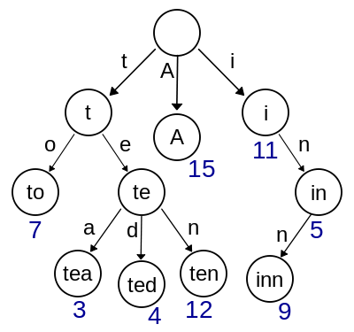

Slide 88
Patricia trees
Patricia trie is a data structure which is also called Prefix tree, radix tree or trie
Trie uses a key as a path so the nodes that share the same prefix can also share the same path.
This structure is fastest at finding common prefixes, simple to implement, and requires small memory.
it is commonly used for implementing routing tables, systems that are used in low specification machines like the router.

Slide 89
Merkle Patricia Trie
In the MPT, as well as in the Merkle tree, every node has a hash value.
Each node’s hash is decided by the sha3 hash value of its contents.
This hash is also used as the key that refers to the node.
Go-ethereum uses levelDB, and parity uses rocksDB to store states.
They are key-value storages.
Keys and values saved in the storage are not the key-values of the Ethereum state.
The value that is stored in the storage is the content of MPT node while the key is the hash of this node.

Slide 90
Hash Tables
Store arbitrary keys and satellite data (value)
put(key,value)
value = get(key)
Lookup must be fast
Calculate hash function h() on key that returns a storage cell
Chained hash table: Store key there

Slide 91
Distributed hash tables (DHTs)
A hash table is a data structure that is used to map keys to values.
Internally, a hash function is used to calculate an index into an array of buckets, from which the required value can be found.
Buckets have records stored in them using a hash key and are organized in a particular order.
Distributed hash table as a data structure where data is spread across various nodes and nodes are equivalent to buckets in a peer-to-peer to network.

Slide 92
What is a DHT?
Hash Table
data structure that maps “keys” to “values”
essential building block in software systems
Distributed Hash Table (DHT)
similar, but spread across many hosts
Interface
insert(key, value)
lookup(key)

Slide 94
Distributed hash tables (DHTs)
Data is passed through a hash function, which results in generating a compact key.
This key is then linked with the data (values) on the peer-to-peer network.
When users on the network request the data (via the filename), the filename can be hashed again to produce the same key
any node on the network can then be requested to find the corresponding data.
DHTs provides decentralization, fault tolerance, and scalability:

Slide 95
How do DHTs work?
Every DHT node supports a single operation:
Given key as input; route messages to node holding key
DHTs are content-addressable

Slide 96
DHT: basic idea
K V
K V
K V
K V
K V
K V
K V
K V
K V
K V
K V

Slide 97
DHT: basic idea
K V
K V
K V
K V
K V
K V
K V
K V
K V
K V
K V
Neighboring nodes are “connected” at the application-level

Slide 98
DHT: basic idea
K V
K V
K V
K V
K V
K V
K V
K V
K V
K V
K V
Operation: take key as input; route messages to node holding key

Slide 99
DHT: basic idea
K V
K V
K V
K V
K V
K V
K V
K V
K V
K V
insert(K₁,V₁)
K V
Operation: take key as input; route messages to node holding key

Slide 100
DHT: basic idea
K V
K V
K V
K V
K V
K V
K V
K V
K V
K V
insert(K₁,V₁)
K V
Operation: take key as input; route messages to node holding key

Slide 101
DHT: basic idea
(K₁,V₁)
K V
K V
K V
K V
K V
K V
K V
K V
K V
K V
K V
Operation: take key as input; route messages to node holding key

Slide 102
DHT: basic idea
K V
K V
K V
K V
K V
K V
K V
K V
K V
K V
K V
retrieve (K₁)
Operation: take key as input; route messages to node holding key

Slide 103
DHT
Distributed application
put(key, data)
get (key)
data
Distributed hash table
(DHash)
lookup(key)
node IP address
Lookup service
(Chord)
node
node
….
node
Application may be distributed over many nodes
DHT distributes data storage over many nodes

Slide 104
Digital signatures
Digital signatures provide a means of associating a message with an entity from which the message has been originated.
Digital signatures are used to provide data origin authentication and non- repudiation.
They are calculated in two steps.

Slide 105
Digital signatures
Calculate the hash value of the data packet.
This will provide the data integrity guarantee as hash can be computed at the receiver's end again and matched with the original hash to check whether the data has been modified in transit.
Message signing can work without hashing the data first, but is not considered secure.
Signs the hash value with the signer's private key.
As only the signer has the private key, the authenticity of the signature and the signed data is ensured.

Slide 106
Digital signatures
Digital signatures have some important properties, such as
Authenticity
unforgeability,
nonreusability.
Authenticity means that the digital signatures are verifiable by a receiving party.
Unforgeability property ensures that only the sender of the message is able to use the signing functionality using the private key.
no one else should be able to produce the signed message that has been produced by the legitimate sender.
Nonreusability means that the digital signature cannot be separated from a message and used for another message again.

Slide 108
Digital signatures
If a sender wants to send an authenticated message to a receiver, there are two methods that can be used.
These two approaches to use digital signatures with encryption are
Sign then encrypt
In this approach, the sender digitally signs the data using the private key, appends the signature to the data,
Then encrypts the data and the digital signature using the receiver's public key.
Encrypt then sign
In this approach, the sender encrypts the data using the receiver's public key
Then digitally signs the encrypted data.

Slide 109
Digital signatures
In practice, a digital certificate that contains the digital signature is issued by a certificate authority (CA) that associates a public key with an identity.
Various schemes, such as RSA, Digital Signature Algorithm, and Elliptic Curve Digital Signature Algorithm-based digital signature schemes are used in practice.
RSA is the most commonly used;
With the traction of elliptic curve cryptography, ECDSA-based schemes are also becoming quite popular.

Slide 110
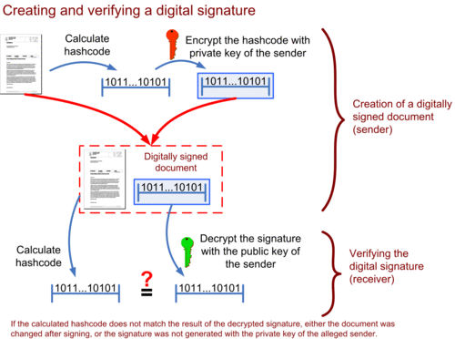

Slide 111
Fully Homomorphic Encryption

Slide 112
The goal
Delegate processing of data
without giving away access to it
Notes:
Assume that I have a piece of data, I want some computation to be performed on this data nad I want to get the result. But for some reason, I don’t want to do the computation myself. Perhaps because the computation is too expensive and I don’t simply have enough resou to do it myself. In other words, I want to delegate processing to someone else, I want them to do the computation for me, but I don’t want them to see what my data is.

Slide 113



Example 1: Private Search
Delegate PROCESSING of data
without giving away ACCESS to it
You: Encrypt the query, send to Google
(Google does not know the key, cannot “see” the query)
Google: Encrypted query → Encrypted results
(You decrypt and recover the search results)

Slide 114

Example 2: Private Cloud Computing
Delegate PROCESSING of data
without giving away ACCESS to it
Encrypt x
Enc(x), P → Enc(P(x))
(Input: x)
(Program: P)

Slide 115




Fully Homomorphic Encryption
[Rivest-Adleman-Dertouzos’78]
Knows nothing of x.
Enc(x)
x
Function f
Eval: f, Enc(x) → Enc(f(x))
homomorphic evaluation

Slide 116
Homomorphic encryption
Usually, public key cryptosystems, such as RSA, are multiplicative homomorphic or additive homomorphic, such as Paillier cryptosystem, and are called partially homomorphic systems.
Additive PHEs are suitable for e-voting and banking applications.
In 2009, a fully homomorphic system was discovered by Craig Gentry.
As these schemes allow the processing of encrypted data without the need for decryption,
for example, cloud computing and online search engines.
Recent development in homomorphic encryption has been very promising
researchers are actively working to make it efficient and more practical.
This is of particular interest in the blockchain technology, because it can solve the problem of confidentiality and privacy in blockchain.

Slide 117
Signcryption
Signcryption is a public key cryptography primitive that provides all the functions of the digital signature and encryption.
It was invented by Yuliang Zheng and is now an ISO standard ISO/IEC 29150:2011.
Traditionally, signature then encrypt or encrypt then sign schemes are used to provide unforgeability, authentication, and nonrepudiation,
But with Signcryption, all services of digital signatures and encryption are provided with cost less than that of sign then encrypt schemes.
Cost (signature & encryption) << Cost (signature) + Cost (Encryption)

Slide 118
Features of Digital Signcryption
Unique Unsigncryptability
message m of arbitrary length is Signcrypted using Signcryption algorithm
This gives you a Signcrypted output c
The receiver can apply Unsigncryption algorithm on c to verify the message m
This Unsigncryption is unique to the message m and the sender

Slide 119
Features of Digital Signcryption
Security
Two security schemes
Digital Signature
Public Key encryption
likely to be more secure
ensures that the message sent couldn’t be forged
ensures the contents of the message are confidential
ensures non-repudiation

Slide 120
Features of Digital Signcryption
Efficiency
Computation involved when applying the Signcryption, Unsigncryption algorithms and communication overhead is much smaller than signature-then-encryption schemes

Slide 121
Zero knowledge proofs
Zero knowledge proofs were introduced by GoldWasser, Micali, and Rackoff.
These proofs are used to prove the validity of an assertion without revealing any information whatsoever about the assertion.
There are three properties of ZKPs that are required, namely
completeness, soundness, and zero-knowledge property.
Completeness ensures that if a certain assertion is true, then the verifier will be convinced of this claim by the prover.
Soundness property makes sure that if an assertion is false, then no dishonest prover can convince the verifier otherwise.
Zero-knowledge property, is the key property of zero knowledge proofs whereby it is ensured that absolutely nothing is revealed about the assertion except whether it is true or false.

Slide 122
Zero knowledge proofs
Zero knowledge proofs have sparked a special interest among researchers in the blockchain space due to its privacy properties that are very much desirable in financial and many other fields, such as law and medicine.
A recent example of the successful implementation of the zero knowledge proof mechanism is the Zcash crypto currency.
In Zcash, a specific type of zero knowledge proof, known as zero-knowledge Succinct Non-interactive Argument of Knowledge (ZK-Snark), is implemented.

Slide 123
Blind signatures
Blind signatures were introduced by David Chaum in 1982 and are based on public key digital signature schemes, such as RSA.
The key idea behind blind signatures is to get the message signed by the signer without actually revealing the message.
This is achieved by disguising or blinding the message before signing it, hence the name blind signatures.
This blind signature can then be verified against the original message just like a normal digital signature.
Blind signatures were introduced as a mechanism to allow the development of digital cash schemes.

Slide 124
Encoding schemes
Other than cryptographic primitives, binary to text encoding schemes are also used in various scenarios.
The most common usage is to convert binary data into text so that it can be either processed, saved, or transmitted via a protocol that does not support the processing of binary data.
For example, sometimes, images are stored in the database as base64 encoding, which allows a text field to be able to store a picture.
Another encoding named base58 was popularized by its usage in bitcoin.

Slide 125
References
Imran Bashir. “Mastring BlockChain”, Packt
Web Materials

